Slide 1
CADD training cohort-3 Assignment-1
Priyanka Rajan
4/7/26

Slide 2
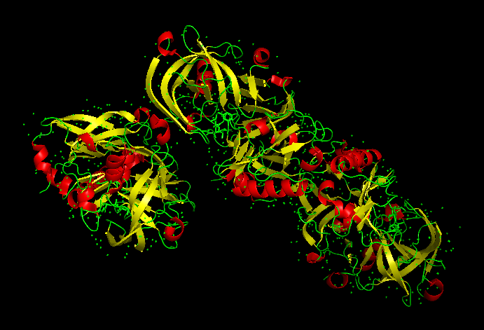
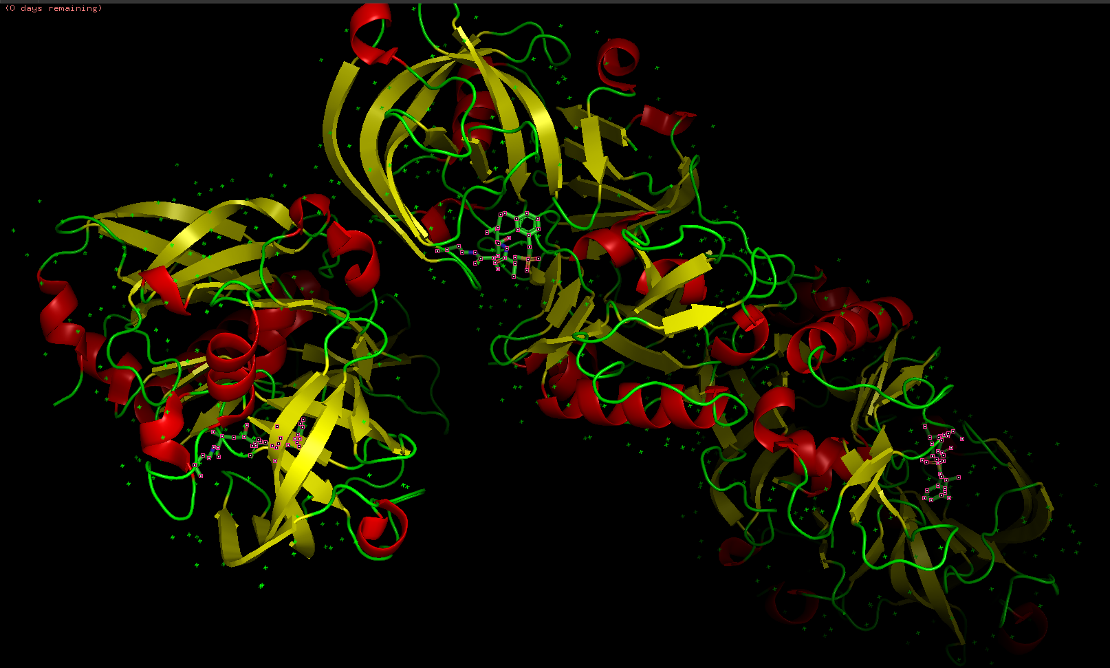
Task-1 BACE complex download and visualization
Protein name:
Biological relevance
Selected PDB ID: 5QCU
Experimental method used: X-Ray diffraction
Resolution value: 1.95A
Presence or absence of co-crystallized ligand: Yes
A short written justification

Slide 3
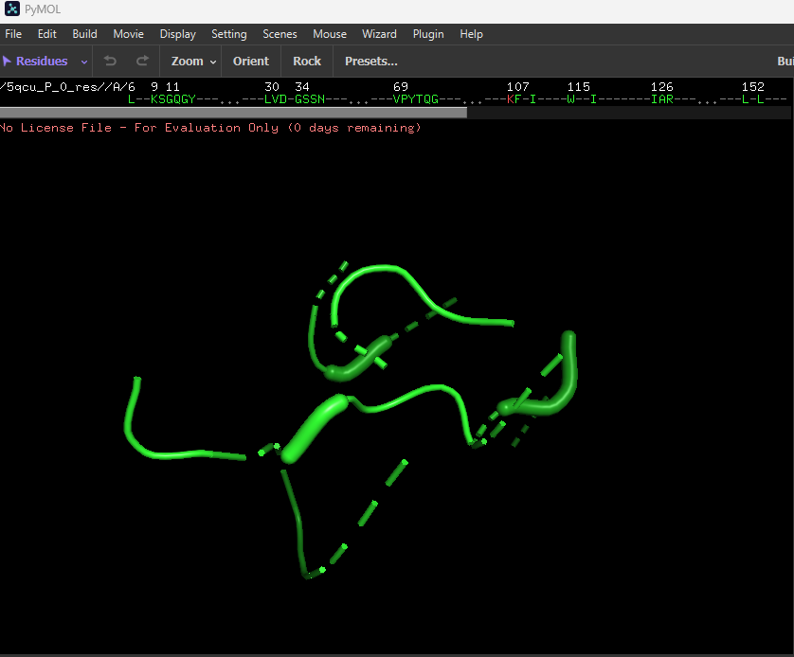
Task-2 Binding pocket prediction
Some of the residues present in the binding pocket are L, K, S, G, Q, Y, V and D
The 3D structure of BACE complex protein (ID: 5QCU) was retrieved from Protein Data Bank and input into Proteins Plus. The binding site was detected in chain A of the complex using DoGsite scorer.

Slide 4
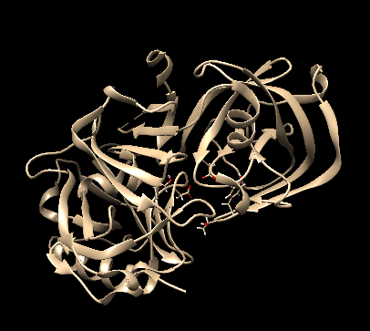
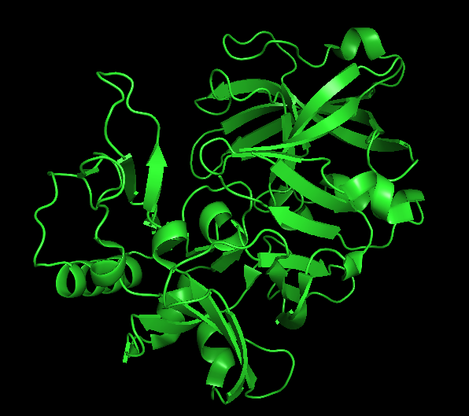
Task 3: Protein preparation and cleaning
Before Dockprep
Preparation steps:
The 3D structure of BACE complex (PDB ID: 5QCU) was downloaded from Protein Data Bank. In Chimera, the proten was cleaned up, by removing water and other co-crystallized ligands and the chains B and C. The chain A shown on the top panel was saved using dockprep command in .pdb format. The saved structure was visualized in PyMol.
After Dockprep

